Slide 1

Department of Computer Engineering
OUTLINE
What is template?
Function templates and class templates
Overloading Template Functions
Inheritance and Templates
Templates and Friend Function
try-catch throw
Multiple catch
catch all
Re-throwing Exception
Overview and use of Standard Template Library

Slide 2
Department of Computer Engineering
What is template?
C++ templates are a powerful feature of the C++ programming language that allows for generic programming.
Templates provide a way to define generic classes or functions that can work with different data types without sacrificing type safety or performance.
Templates allow you to define parameterized types or functions, where one or more types can be specified as parameters.
These parameters can be used to define variables, classes, or functions that can work with any type specified when using the template.

Slide 3
Department of Computer Engineering
What is template?
Templates concept enables us to define generic classes and functions.
This allows a function or class to work on many different data types without being rewritten for each one.
Templates
Function Template
Class Template
Templates

Slide 4
Need of Templates
int add(int x, int y)
{
return x+y;
}
float add(float x, float y)
{
return x+y;
}
char add(char x,char y)
{
return x+y;
}
double add(double x, double y)
{
return x+y;
}
We need a single function that will work for int, float, double etc…
Notes:
Imagine a datatype that will adjust itself
Rewriting the same function body over and over for different types is time-consuming and
wastes space in the listing. Also, if you find you’ve made an error in one such function, you’ll

Slide 5
Function Template
Suppose you write a function printData:
void printData(int value){
cout<<"The value is "<<value;
}
Now if you want to print double values or string values, then you have to overload the function:
void printData(float value){
cout<<"The value is "<<value;
}
void printData(char *value) {
cout<<"The value is "<<*value;
}
To perform same operation with different data type, we have to write same code multiple time.

Slide 6
Function Template
C++ provides templates to reduce this type of duplication of code.
template<typename T>
void printData(T value){
cout<<"The value is "<<value;
}
We can now use printData for any data type. Here T is a template parameter that identifies a type.
Then, anywhere in the function where T appears, it is replaced with whatever type the function is instantiated.
int i=3;
float d=4.75;
char *s="hello";
printData(i); // T is int
printData(d); // T is float
printData(s); // T is string

Slide 7
Department of Computer Engineering
Function template
A function template specifies how an individual function can be constructed.
When defining a function template, you specify the function's signature and behavior using placeholders called type parameters or template parameters.
These parameters represent generic types and can be used throughout the function's code.
The actual types are determined when the function template is instantiated or called with specific types.

Slide 8
Department of Computer Engineering
Function template
Syntax:
template <typename T>
return type functionname(T arg1,T arg2)
{
//function body;
}
Note: template <class T> is also valid and mean the same for creating function template.

Slide 9
Largest of Two numbers using Function Template
#include <iostream>
using namespace std;
template <typename T>
T Large(T n1, T n2)
{
return (n1 > n2) ? n1 : n2;
}
int main(){
int i1, i2;
float f1, f2;
char c1, c2;
cout << "Enter two integers:\n";
cin >> i1 >> i2;
cout << Large(i1, i2) <<" is larger." << endl;
cout << "\nEnter two floating-point numbers:\n";
cin >> f1 >> f2;
cout << Large(f1, f2) <<" is larger." << endl;
cout << "\nEnter two characters:\n";
cin >> c1 >> c2;
cout << Large(c1, c2) << " has larger ASCII value.";
}

Slide 10
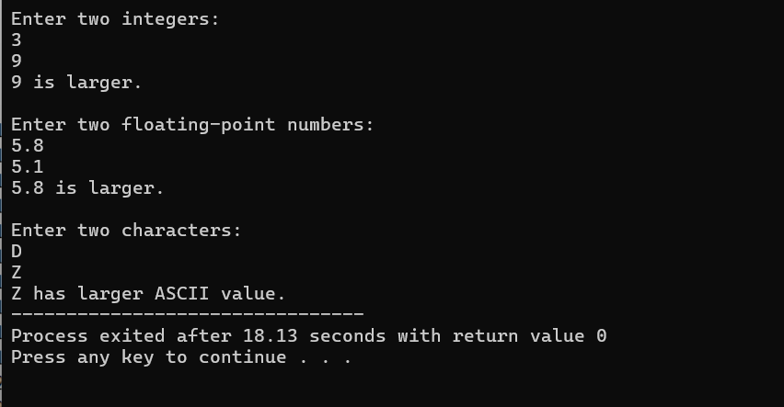
Largest of Two numbers using Function Template
Output:

Slide 11
Swap of Two numbers using Function Template
#include <iostream>
using namespace std;
template <class T>
void Swap(T &a, T &b)
{T temp = a;
a = b;
b = temp;
}
int main()
{
int i1, i2;
float f1, f2;
char c1, c2;
cout<<"Enter two integers:\n";
cin >>i1>>i2;
Swap(i1, i2);
cout<<"After swapping: "<<i1<<" "<<i2<<endl;
cout<<"\nEnter two floating-pointnumbers:\n";
cin>> f1 >> f2;
Swap(f1, f2);
cout<<"After swapping: "<<f1<<" "<<f2<<endl;
cout<<"\nEnter two characters:\n";
cin>>c1>>c2;
Swap(c1, c2);
cout<<"After swapping: "<<c1<<" "<<c2<<endl;
return 0;
}

Slide 12
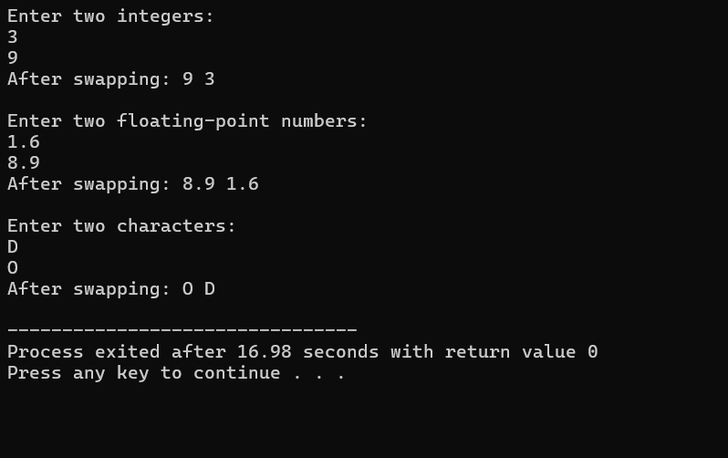
Swap of Two numbers using Function Template
Output:

Slide 13
Department of Computer Engineering
Class template
A class template in C++ is a blueprint for creating generic classes that can work with different data types.
It allows you to define a class that can be customized to work with various types without having to rewrite the class code for each type.
The syntax for defining a class template is similar to that of a regular class, with the addition of one or more type parameters enclosed in angle brackets (<>).
These type parameters represent generic types and can be used throughout the class definition.

Slide 14
Department of Computer Engineering
Class template
Syntax:
template <class T>
class classnm
{
private:
T member1;
T member2;
…
public:
T fun();
…
};
objects for class template is created like:
classname <datatype> obj;
Variable and function can be accessed like:
obj.variable;
obj.memberfunction();

Slide 15
Object of template class
The object of template class are created as follows
class name <data type> object name;
template<class T>
class sample
{
T a,b;
public:
void getdata()
{
cin>>a>>b;
}
void sum();
};
int main()
{
sample <int>s1;
sample <float>s2;
s1.getdata();
s1.sum();
s2.getdata();
s2.sum();
}

Slide 16
template<class T1, class T2>
class Sample
{
T1 a; T2 b;
public:
Sample(T1 x,T2 y){
a=x;
b=y;
}
void disp(){
cout<<"\na="<<a<<"\tb="<<b;
}
};
Class Template Example
To create a class template object,
define the data type inside a < > at the time of object creation.
className<int> classObj; className<float> classObj;
int main(){
Sample <int,float> S1(12,23.3);
Sample <char,int> S2('N',12);
S1.disp();
S2.disp();
}

Slide 17
Calculator using Class Template
#include <iostream>
using namespace std;
template <class T>
class Calculator {
private:
T num1, num2;
public:
Calculator(T a, T b) {
num1 = a;
num2 = b; }
T add() {
return num1 + num2; }
T subtract() {
return num1 - num2; }
T multiply() {
return num1 * num2; }
T divide() {
return num1 / num2; }
}
};
int main() {
int a, b;
float x,y;
cout << "Enter two integers:\n";
cin >> a >> b;
Calculator<int> i(a, b);
cout << "Addition: " << i.add() << endl;
cout << "Subtraction: " << i.subtract() << endl;
cout << "Multiplication: " << i.multiply() << endl;
cout << "Division: " << i.divide() << endl;
cout << "\nEnter two floating-point numbers:\n";
cin >> x >> y;
Calculator<float> f(x, y);
cout << "Addition: " << f.add() << endl;
cout << "Subtraction: " << f.subtract() << endl;
cout << "Multiplication: " << f.multiply() << endl;
cout << "Division: " << f.divide() << endl;
return 0;
}

Slide 18
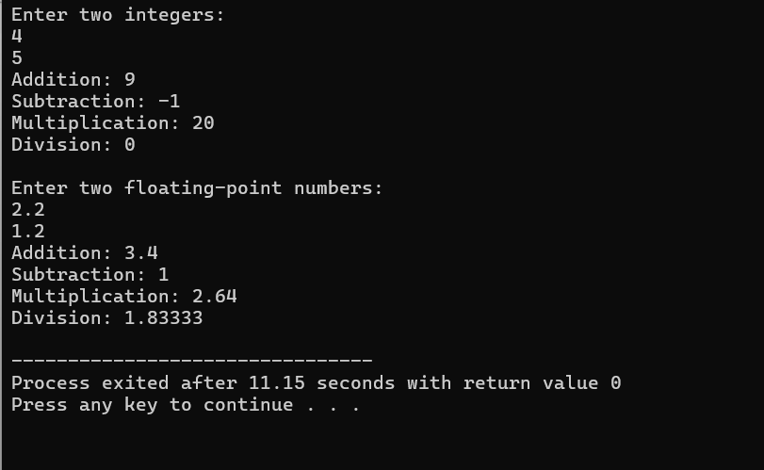
Calculator using Class Template
Output:

Slide 19
Overloading function templates
You may overload a function template either by a non-template function or by another function template.
If you call the name of an overloaded function template, the compiler will try to deduce its template arguments and check its explicitly declared template arguments.
If successful, it will instantiate a function template specialization, then add this specialization to the set of candidate functions used in overload resolution.
The compiler proceeds with overload resolution, choosing the most appropriate function from the set of candidate functions. Non-template functions take precedence over template functions.

Slide 20
Overloading function templates
#include <iostream>
using namespace std;
template<class T>
void f(T x, T y) {
cout << "Template" << endl;
}
void f(int w, int z) {
cout << "Non-template" << endl;
}
int main() {
f( 1 , 2 );
f('a', 'b’);
f( 1 , 'b’);
}
Output :
Non-template
Template
Non-template

Slide 21
Inheritance and templates
#include <iostream>
using namespace std;
template <typename T>
class Base {
public:
T value;
};
template <typename T>
class Derived : public Base<T> {
public:
void show() {
cout << "Value: " << this->value << endl;
}
};
int main() {
Derived<int> obj;
obj.value = 5;
obj.show();
return 0;
}
Output :
Value: 5

Slide 22
Template and Friend Function
#include <iostream>
using namespace std;
template <typename T>
class Box {
private:
T value;
public:
Box(T val) { // constructor
value = val;}
// Friend function declaration
friend void showValue(Box<T> b) {
cout << "Value: " << b.value << endl;
}
};
int main() {
Box<int> b1(10);
Box<string> b2("Hello");
showValue(b1);
showValue(b2);
return 0;
}
Output :
Value: 10
Value:Hello

Slide 23
Exception Handling – Introduction
Errors are the problems that occur in the program due to an illegal operation performed by the user or by the fault of a programmer.
Exception Handling is the process of handling errors and exceptions such that the normal execution of the system is not halted.
Exception handling in C++ consists of three keywords namely- try, catch, and throw.

Slide 24
Exception Handling
Errors in C++
Errors are the problems that occur in the program due to an illegal operation performed by the user or by the fault of a programmer, which halts the normal flow of the program.
Errors are also termed bugs or faults.
There are mainly two types of errors in programming. They are,
Compile Time Errors
Run-Time Errors

Slide 25
Department of Computer Engineering
Exception Handling
Compile Time Errors
Compile Time Errors are those errors that are caught during compilation time.
Some of the most common compile-time errors are,
Syntax errors
Library references
Incorrect import of library functions and methods
Uneven bracket pair(s), etc.

Slide 26
Department of Computer Engineering
Exception Handling
Run-Time Errors
Run-Time Errors are those errors that cannot be caught during compilation time.
As we cannot check these errors during compile time, we name them Exceptions.
Exceptions can cause some serious issues so we should handle them effectively.
We use the exception handling in C++ is to separate the error handling code from the normal code. For exception handling in C++, we use the try-catch finally block.

Slide 27
Department of Computer Engineering
Exception Handling
Syntax:
try
{
throw exception; // Block of code to try
}
catch ()
{
// Block of code to handle errors
}

Slide 28
Exception-Example
int main()
{
int a,b,c;
cout<<"Enter value a=";
cin>>a;
cout<<"Enter value b=";
cin>>b;
c=a/b;
cout<<"answer="<<c;
}
Output:
Enter value a=5
Enter value b=2
answer=2
Output:
Enter value a=5
Enter value b=0
Abnormal Termination occur

Slide 29
Why Exception Handling?
Exception handling in C++ separates error handling code from normal code to ensure that the normal execution of the program is not interrupted by errors or exceptions.
Unlike using multiple if-else conditions to handle errors, exception handling improves code readability and maintainability by allowing developers to easily manage exceptional situations.

Slide 30
Try, Throw and Catch
C++ exception handling mechanism is built upon three keywords try, throw and catch.
try
{
.....
throw exception; //this block detects and throws an exception
}
catch(type arg)
{
.....
... //exception handling block
}
.....
try block
Detects and throws an exception
Exception
Object
catch block
Catches and handles the exception

Slide 31
Try-Catch Example
int main()
{
int a,b,c;
cout<<"Enter two values=";
cin>>a>>b;
try
{
if(b!=0)
c=a/b;
cout<<"answer="<<c;
else
throw(b);
}
catch(int x)
{
cout<<"Exception caught: Divide by zero\n";
}
}
Output:
Enter value a=5
Enter value b=0
Exception caught: Divide by zero

Slide 32
Exception Handling - Example
#include <iostream>
using namespace std;
int division(int a, int b)
{
if (b == 0) // checking if the denominator is 0 or not.
{
throw "Division by zero!"; /*if the denominator is 0, then we must throw an exception*/
}
return int(a / b); // if there is no exception, then we are returning the answer.
}
int main()
{

Slide 33
Exception Handling - Example
int x = 50, int y = 0, answer = 0;
/* Using a try catch block because in divison, the denominator can be 0. So, we must handle the 0 divion inside try block.*/
try {
answer = division(x, y);
cout << " Output: " << answer << endl;
}
catch (const char *errorMessage) // printing the thrown exception from the function
{
cout << errorMessage << endl;
}
return 0;
}

Slide 34
Multiple Catch -Example
void test(int x){
try
{
if(x==1)
throw x;
else if(x==0)
throw 'x';
else if(x==-1)
throw 5.14;
}
catch(int i){
cout<<"\nCaught an integer";
}
catch(char ch){
cout<<"\nCaught a character";
}
catch(double i){
cout<<"\nCaught a double";
}
}
int main()
{
test(1);
test(0);
test(-1);
}
Output:
Caught an integer
Caught a character
Caught a double

Slide 35
Catch All Exception
In some situations, we may not predict all possible types of exceptions and therefore may not be able to design independent catch handlers to catch them.
Syntax:
catch(...)
{
//statements for processing all exceptions
}

Slide 36
Catch All Exception
#include<iostream>
using namespace std;
void test(int x)
{
try
{
if(x==0) throw x;
if(x==-1) throw 'a';
if(x==1) throw 5.15;
}
catch(...)
{
cout<<"Caught an exception\n";
}
}
int main()
{
test(-1);
test(0);
test(1);
}
Output:
Caught an exception
Caught an exception
Caught an exception

Slide 37
Re –Throwing Exception
An exception is thrown from the catch block is known as the re-throwing exception.
It can be simply invoked by throw without arguments.
Rethrown exception will be caught by newly defined catch statement.

Slide 38
Re –Throwing Exception
int main()
{
try
{
divide(10.5,2.0);
divide(20.0,0.0);
}
catch(double)
{
cout<<"Exception inside main function";
}
}
void divide(double x, double y){
try
{
if(y==0)
throw y;
else
cout<<"Division="<<x/y;
}
catch(double)
{
cout<<"Exception inside function\n";
throw;
}
}
Output:
Division=5.25
Exception inside function
Exception inside main function

Slide 39
Exceptions thrown from functions
#include <iostream>
using namespace std;
void test(int x)
{
cout<<"Inside function:"<<x<<endl;
if(x) throw x;
}
int main()
{
cout<<"Start"<<endl;
try
{
test(0);
test(1);
test(2);
}
catch(int x)
{
cout<<"Caught an int exception:"<< x<<endl;
}
}

Slide 40
STL (Standard Template Library)
The C++ STL (Standard Template Library) is a powerful set of C++ template classes to provides general-purpose templatized classes and functions that implement many popular and commonly used algorithms and data structures like vectors, lists, queues, and stacks.
There are three core components of STL as follows:
Containers (an object to store data)
Algorithms (procedure to process data)
Iterators (pointer object to point elements in container)

Slide 41
STL -Containers
A container is an object the actually stores data.
The STL containers can be implemented by class templates to hold different data types.
Containers
vector
deque
list
set
multiset
map
multimap
stack
queue
Priority-queue
Store elements in linear sequence
Direct access to elements using keys
Derived from sequence containers

Slide 42
STL -Algorithms
It is a procedure that is used to process data contained in containers.
It includes algorithms that are used for initializing, searching, copying, sorting and merging.
Mutating Sequence Algorithms
like copy(), remove(), replace(), fill(), swap(), etc.,
Non Modifying sequence Algorithms
like find(), count(),search(), mismatch(), and equal()
Numerical Algorithms
accumulate(), partial_sum(), inner_product(), and adjacent_difference()

Slide 43
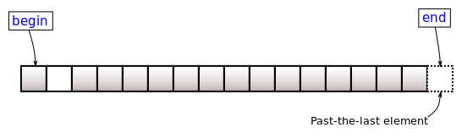
STL -Iterators
Iterators behave like pointers.
Iterators are used to access container elements.
They are used to traverse from one element to another.

Slide 44
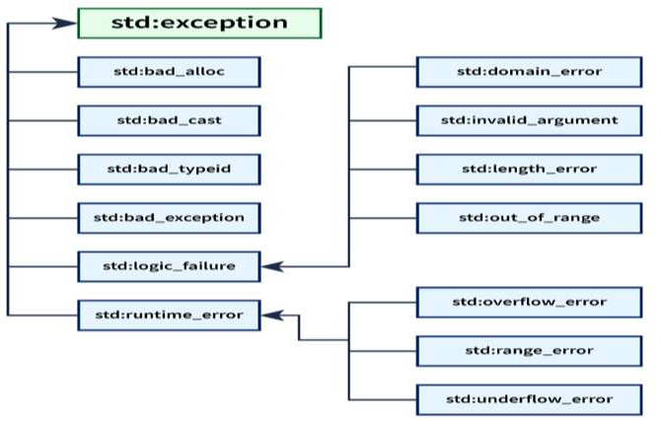
Department of Computer Engineering
C++ Standard Exceptions
The C++ library has some built-in standard exceptions under the <exception> header which can be used in our program.
The standard exceptions are arranged in a parent-child class hierarchy.

Slide 45
Department of Computer Engineering
C++ Exception Classes
class name | use case
std::exception | std::exception is the parent class of all the standard C++ exceptions. So, it contains declarations and definitions of other exceptions.
std::bad_alloc | std::bad_alloc is the type of exception thrown by the allocation functions to report failure to allocate storage.
std::bad_cast | std::bad_cast is the type of exception thrown when a dynamic_cast to a reference type fails the run-time check.
std::bad_exception | std::bad_exception is used to handle unexpected exceptions in a C++ program.
std::bad_typeid | std::bad_typeid is the type of exception thrown when a typeid operator is applied to a dereferenced null pointer value of a polymorphic type.
std::logic_error | std::logic_error exception is the type of exception that can be theoretically detected by reading the code.
std::domain_error | std::domain_error is the type of exception thrown when a mathematically invalid domain is used.

Slide 46
Department of Computer Engineering
C++ Exception Classes
class name | use case
std::invalid_argument | std::invalid_argument is the type of exception thrown due to invalid arguments.
std::length_error | std::length_error is the type of exception thrown when a too big std::string is created.
std::out_of_range | std::out_of_range is the type of exception that report errors when we are trying to access elements which is outside of the defined range.
std::runtime_error | std::runtime_error exception is the type of exception that theoretically cannot be detected by reading the code.
std::overflow_error | std::overflow_error exception is the type of exception thrown if a mathematical overflow occurs.
std::underflow_error | std::underflow_error exception is the type of exception thrown if a mathematical underflow occurs.
std::range_error | std::range_error is the type of exception thrown if a mathematical underflow occurs.

Slide 47


